Slide 1

Key Stage One
Curriculum Presentation
1st October 2024
Notes:
Sian Laver slide

Slide 2
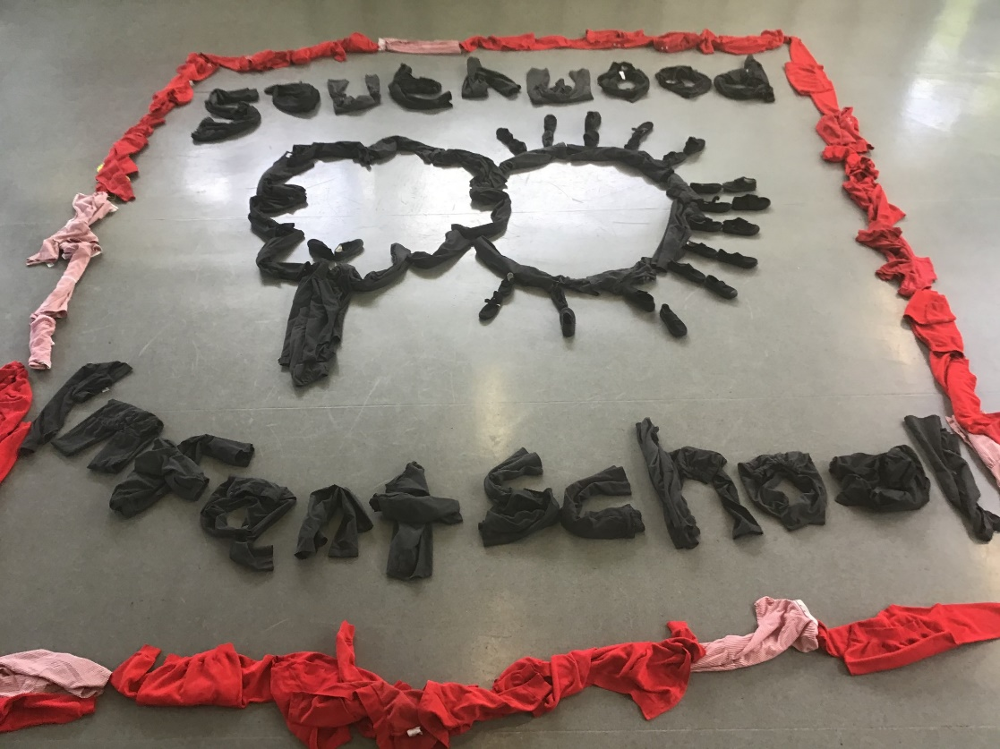
Ethos and Values
At Southwood everything we do is under pinned by our core values
Excellence
Respect
Enjoyment

Slide 3
National Vs School Curriculum
The National Curriculum is set by government.
It prescribes a set of expectations known as ‘Programmes of Study’.
Provides a core set of knowledge, skills and dispositions to be taught with some assessment criteria.
The School Curriculum plans a programme of teaching to cover the required curriculum content.
Provides meaningful contexts within which teaching and learning take place.
Has a focus on exciting, hands on learning opportunities to bring the curriculum to life.
Teaches via half-termly themes / topics.
Is whole-child focussed providing active, creative learning opportunities with trips, visitors, drama, music, art, the outdoors and ICT built into learning.

Slide 4
Transition
The children came for several different sessions in the Summer Term to meet all the team and then specific sessions with their class teachers.
We have timetabled the curriculum for the return to school carefully, to allow children to get use to the new routines in their new year group and plenty of time for PSHE (Personal, Social and Health Education) to help them in returning to school and in adjusting to the new key stage.
Outside provision is used to enhance our learning and to help offer a varied timetable to ease transition back into school. This helps engage the children, but also allows for sensory and movement breaks for the children.

Slide 5
How does the split class work?
We have to organise the classes to meet the needs of the specific cohort.
This year we have 2 year R classes and 3 mixed year 1 and 2 classes, known as Key Stage 1.
We have a 2 year rolling curriculum for our topics so all KS1 children will learn about the same topic at the same time.
Maths differs from this and has a specific yearly curriculum for year 1 and year 2. The children would be working on the same area of maths at the same time but with different objectives.
We have skilled teaching assistant and we timetable in a flexible way to allow all the groups to have a good mix of teacher led sessions and independent sessions to practise the skills taught.

Slide 6


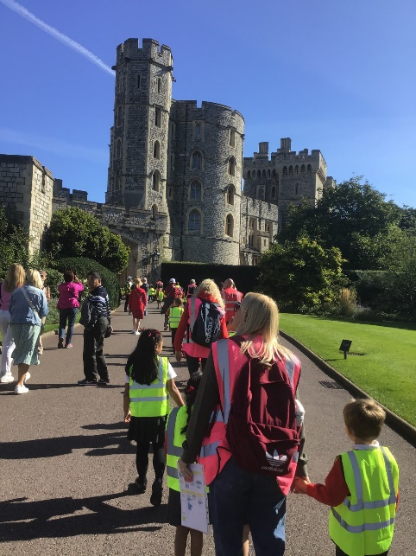

Topics
Castles, Kings and Queens – a history based topic
Toys – a history and storybook based topic
Mighty Machines – a science and DT based topic
Brilliant Birds – a science and art based topic
Going Green – a geography, PSHE and science topic
H20 – a history based topic (Titanic)
We try to link all subjects to the topic. Texts used in literacy will be topic themed through story or non-fiction.
Notes:
Suki

Slide 7
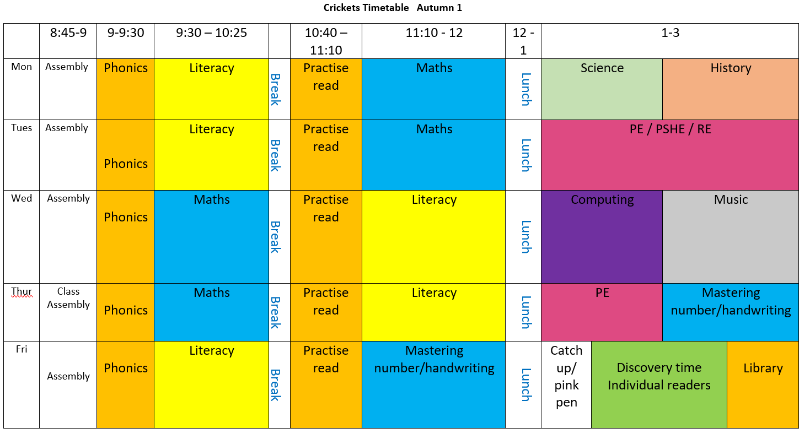
Typical timetable
This shows the general structure of our week. Within each lesson there may be whole class teaching or teaching in groups with the rest of the children accessing outside learning or independent activities in the classroom

Slide 8
Reading
Reading continues to be a key focus in KS 1.
Children will have 3 practise read sessions a week.
These sessions are in a group and may be with the class teacher or teaching assistant.
1st read – decoding
2nd read – prosody
3rd read - comprehension
We listen to each child read independently in the group but will endeavour to also hear children read independently 1:1 throughout the term.
Notes:
Suki

Slide 9
Reading at Home
The single best way that you can support your child at home is by reading with them.
We send home their practise read book every Friday and they also have a reading for pleasure book that they should be attempting to read themselves. Their library book is a book for sharing at home.
In order to motivate the children the reading diary celebrates the number of reads rather than the number of books read. Please record every reading session with your child at home, where your child has read to you.
There is a star system at the back of the reading diary with rewards and certificates for different achievements.
It is really important that your child is understanding what they have read. Asking your child lots of questions and discussing what they have read is as vital as the decoding the words itself.

Slide 10
Writing Non-Negotiables
In all the children’s writing we expect the following:
capital letter at the beginning of a sentence
finger spaces in between the words
punctuation eg. full stop, at the end of the sentence.
legible handwriting set on the line
We have been working on this since the start of the year.

Slide 11
Year 1 Writing
We will work on embedding those non-negotiable skills throughout the year.
Children will build more stamina for writing.
We will learn about the different types of words we can use in sentences to add more information and make them more interesting.
We will start learning about punctuation that can be used to make writing more interesting.
Within our topics we will look at various types of writing for different purposes.
We have discreet handwriting sessions to teach children how to form cursive letters with a view to them beginning to join their handwriting by the end of the year.

Slide 12
Year 2 Writing
A stronger focus on grammar, punctuation and spellings
A greater understanding on how to improve their work by editing to check for accuracy of spelling, punctuation and correct grammar
Write in a range of styles and begin to understand how words change the feel of a story.
Increase writing stamina by writing for sustained periods of time.

Slide 13
Phonics
We teach phonics 5 times a week following the Little Wandle scheme. Year 1 and year 2 are taught separately.
The children are all currently reviewing what they learnt last year.
Later this term, the year 2 children will move onto the Little Wandle ‘Bridge to Spelling’ programme which will require practising lists of spellings at home.
Year 1 children will complete a statutory Phonics Screening check in June 2023 and further information on this will follow nearer the time.

Slide 14

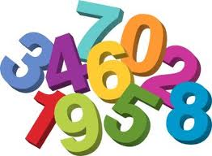
Maths
We follow the Hampshire planning model for maths which is a spiral model so the children can revisit learning throughout the year. The teachers plan the lessons according to the needs of the children in their class.
In addition to these maths lessons we also follow a programme called ‘Mastering Number’ which helps children to understand number and increase their fluency skills. There are separate objectives for Year 1 and Year 2 in both.
Notes:
Sian

Slide 15
Maths
We cover the following areas;
Number and Place Value
Calculations (addition, subtraction, multiplication and division)
Geometry – properties of shapes and position and direction
Measurement, Fractions, Problem solving and Statistics.
Your child will develop their knowledge and understanding of maths through practical and written activities, exploration and discussion.

Slide 16
Homework
Homework will be sent out at the beginning of every half term.
There will be a maths home focus every half term.
Daily Reading (please aim for 5 reads per week if possible) .
There are also weekly spellings which will begin later in the year for Year 2s.
Any work undertaken at home should be in short bursts.
If your child is a reluctant reader at home, don’t force them to read for longer than they are comfortable with. They don’t have to read a whole book each time. Try taking turns reading a page each if that helps.
Notes:
Emma

Slide 17
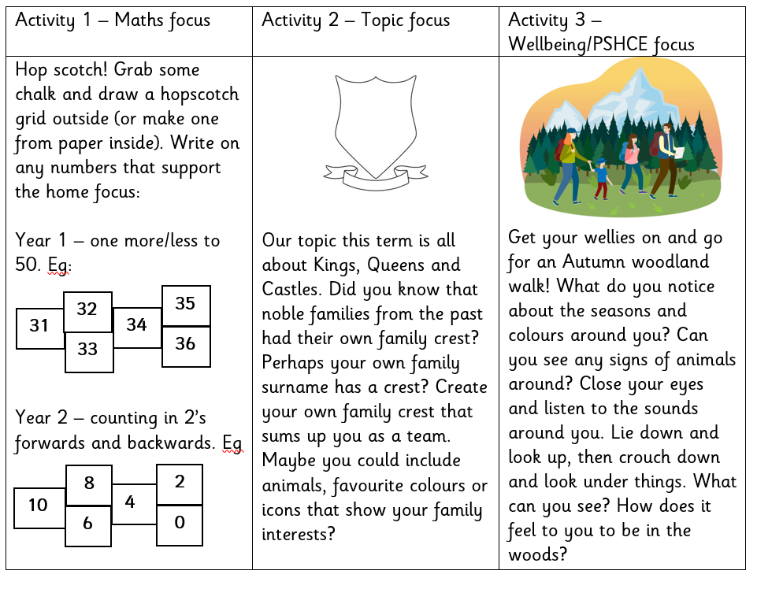
New Homework Format
Every half term we will send home 3 suggested activities, you choose what you are able to do at home.
Towards the end of the half term we will have a session in class where children can share what they did.
32
35
31
34
33
36
8
2
10
4
6
0

Slide 18
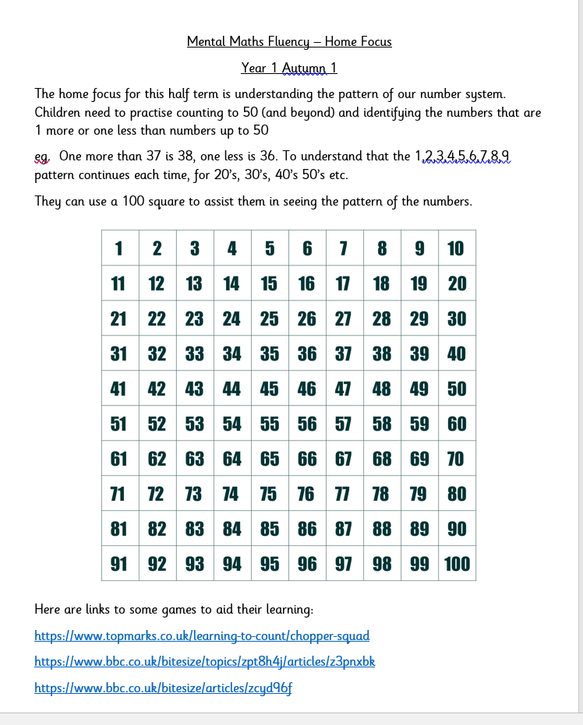
Maths Home Focus
We work on the children’s mental fluency in every maths lesson.
To support their learning at home, we send out a different focus every half term along with links to relevant games, some of which they will have seen in school.
These skills can be practised anytime, anywhere eg. Waiting in the car, on the way to school etc.

Slide 19


End of Year 2 Assessment
Usually the children in Year 2 have undertaken end of Key Stage Assessments (SATS). These tests are now non-statuatory.
The tests are still published every year for schools to use if they choose to.
We will administer the tests to the majority of our year 2’s at the end of the year.
It is done in a very low key way so the children don’t even realise that they are taking a test!
Notes:
Emma

Slide 20
SEND
If you think your child needs extra help or support, or has additional needs, please chat to us about it in our parents meetings or email the office to make an appointment with your child’s teacher.
All information and paperwork about children who have already had a SEND identified in Year R or Year 1 has been passed on to the new classes, and all the children’s previous teachers have written them targets for the start of their new class and for their receiving teacher.
You can always contact our SENCO (special educational needs coordinator ) Miss Park at anytime via the office.

Slide 21
How you can help
Encourage independence, get your children to do as much as they can for themselves – be patient!
Share books together.
Short times spent on reading, maths and spelling- making it fun, hide tricky words around the house!
Remember Maths is everywhere: shopping, numbers on doors, shapes in the environment, board games. Talk about numbers wherever you go.
Please clearly label or personalise your child’s belongings so they can take responsibility and organise their things.

Slide 22
Any Questions?

